Slide 1
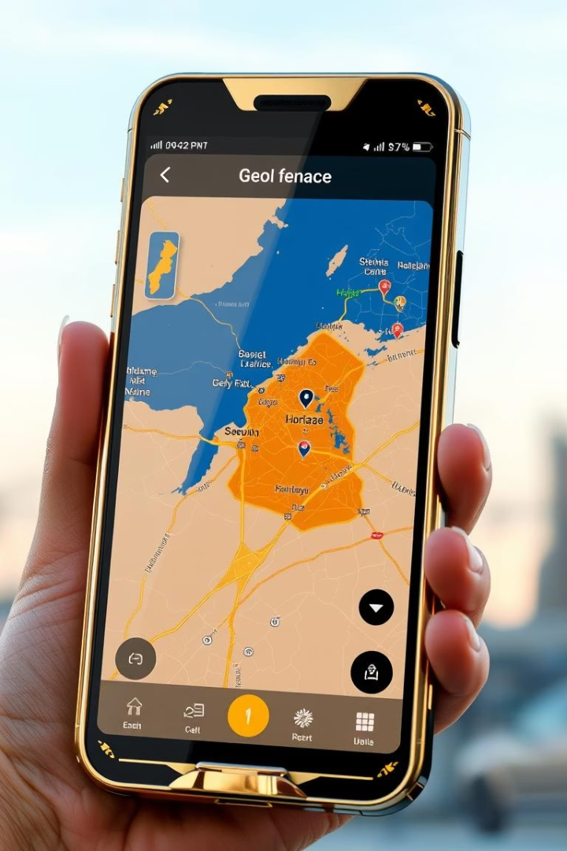
CaptureShield - Geo-fence Based Camera Lock System
Welcome to the final-year project presentation for "CaptureShield - Geo-fence Based Camera Lock System". This project aims to enhance privacy and security by disabling camera functionality within predefined sensitive zones. Developed as part of the Computer Science curriculum at M.Kumarasamy College of Engineering, this system combines advanced geofencing techniques with device management to control camera apps effectively.
KP
by Karthikeyan P

Slide 2
Project Title and Team Details
Project Title
Student Name
CaptureShield - Geo-fence Based Camera Lock System
Karthikeyan V K
College Name
Register Number
M.Kumarasamy College of Engineering
Provided upon request
Department
Supervisor
Computer Science and Engineering (CSE)
Dr. [Supervisor's Name]

Slide 3

Project Objective
Main Goal
Use Case
To automatically disable camera applications such as Snapchat and Instagram in sensitive and restricted zones using geo-fencing.
Protection of privacy and prevention of unauthorized photography in areas like temples, museums, and secure facilities.
Automation
Eliminate manual camera restrictions by leveraging technology for real-time enforcement.

Slide 4

Existing System Limitations
No Automated Enforcement
Manual Restrictions
Limited Coverage
Reliance on signage and manual enforcement leads to inconsistent adherence.
Camera restrictions are often generalized and cannot adapt dynamically to user location.
Current systems lack automated control to disable camera functionality within sensitive areas.

Slide 5
Proposed System: CaptureShield
Technology Stack
Functionality
Android Platform
Automatically detects users entering restricted zones and disables camera apps seamlessly, enhancing privacy without user intervention.
Kotlin Programming Language
DevicePolicyManager for camera control
Real-time Geofencing using Google Maps API

Slide 6
Modules Overview
1
Admin Setup
2
Geofence Creation
Configuration interface for zone creation and setting permissions.
Allows defining virtual boundaries on maps representing restricted areas.
3
User Detection
4
Camera Lock/Unlock
Realtime location monitoring to detect user presence within zones.
Automatic activation or deactivation of camera access using device management APIs.
5
Foreground Service
6
Offline Mode Support
Ensures continuous operation and real-time responsiveness.
Capability to function without internet by saving settings locally.

Slide 7
Module Details: Admin Setup & Geofencing
Admin Setup
Geofence Creation
The administrator defines sensitive areas by pinpointing and customizing zones on an interactive map interface.
Zones are created using GPS coordinates and stored locally and on a remote database for synchronization.
Configurations such as zone radius and enforcement schedules are saved for reliable operation.
Flexible zone management allows updates, additions, or deletions as needed.

Slide 8
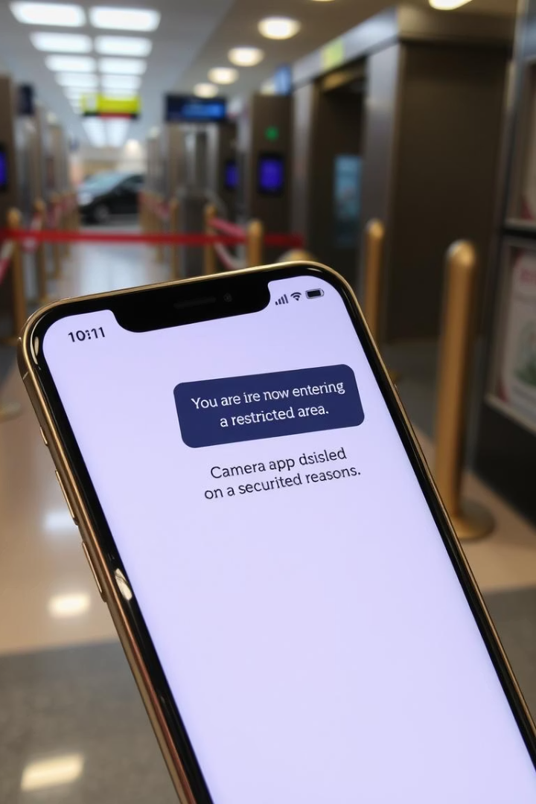
Module Details: User Detection & Camera Locking
User Detection
Continuously monitors the device location relative to geo-fenced areas using GPS and location APIs.
Camera Locking
Once the user enters a restricted zone, a foreground service triggers DevicePolicyManager to disable camera apps instantly.
Camera access is restored automatically upon leaving the zone, ensuring seamless user experience.

Slide 9

Software and Hardware Requirements
Software Tools
Android Studio IDE
Kotlin for application development
Firebase for backend and database services
Google Maps API for geo-fencing
Hardware Requirements
Android devices equipped with GPS capabilities
Internet connectivity for real-time data synchronization

Slide 10
Conclusion and Future Enhancements
Project Benefits
Future Enhancements
Provides automated camera control to protect privacy in sensitive areas. It offers scalability and adaptability through modular design and real-time enforcement.
Potential features include a web-based dashboard for administrative analytics, enhanced user activity monitoring, and integration with additional security systems.

